Slide 1
SHWN_ULIN(UNIVERSAL LOGISTICS INC [CANADA])
Always key the following, visible in the invoice separator sheet:
Batch ID (68) BAT ID (69) Value/No
Client Code (68) CL CODE (69) SHWN
Scac Code (68) SCAC CODE (69) ULIN

Slide 2
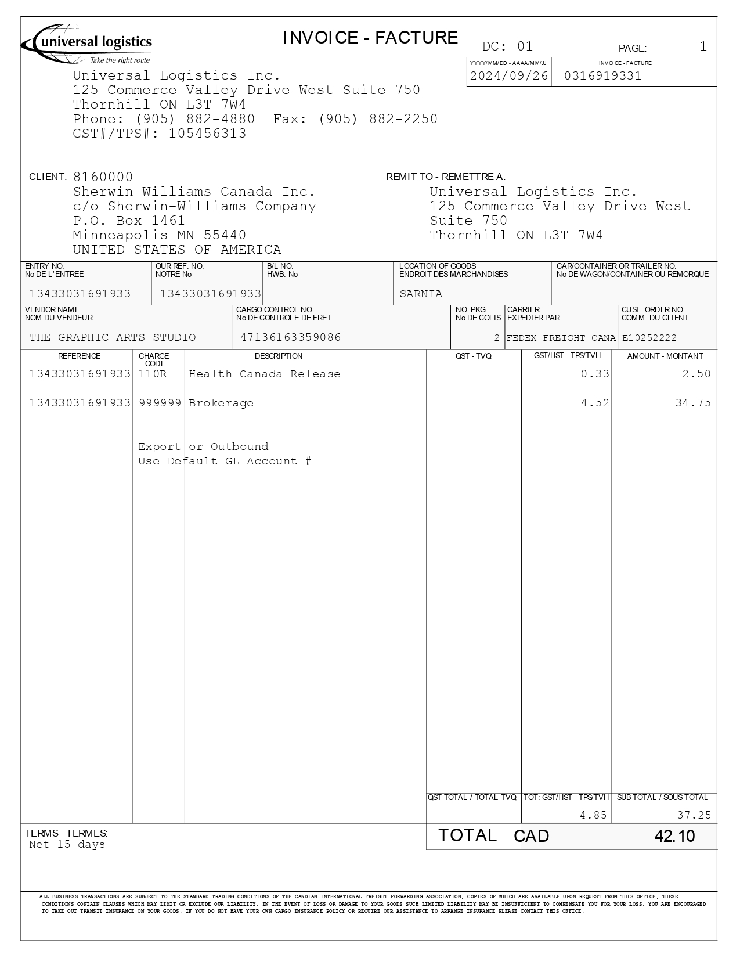
01
03
10
02
68a
46/47
01 REMIT TO
02 BILL TO
03 INV KEY
06 INV AMT BEFORE TAX
07 TAX AMT
09 CURR
10 DATE
46/47 PIECES/ PIECES TYPE
72 LINE ITEM DESC
75 RAtE
85 LINE ITEM AMT
68a REF
68b ORD
08/14 INV AMT/FB AMT
68b
68a
72
85
72
75
07
06
09
08/14

Slide 3
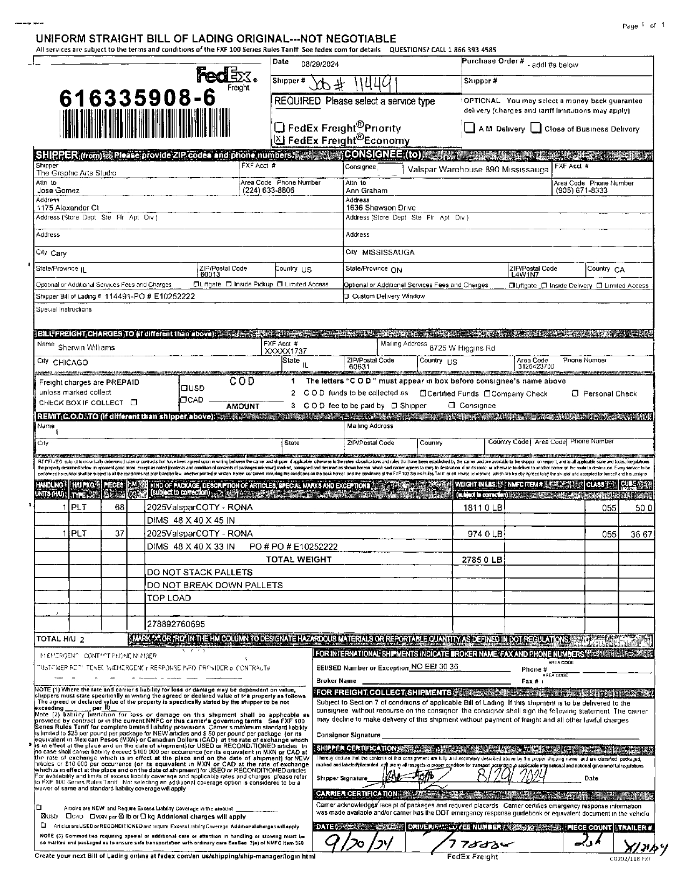
61
68a
28
31
28 SHIPPER BOL
31 CONSIGNEE BOL
36 FRGHT TERM
42/43 ACTUAL WT/ FNCL WT
44/45 ACTUAL WT UOM/ FNCL WT UOM
46/47 PIECES/ PIECES TYPE
50 DIM
61 PICK UP
73 CMDTY
90 PROD DESC
68a JOB NO
68b BOL
68c PO
68b
68c
36
90
73
46/47
50
42/43
44/45

Slide 4
6
For Verification Table
 | NAME | DATE
DI-64836 | Cidjane J. Locaylocay | 10/19/2024
DI-66491 – update according to instruction | Cidjane J. Locaylocay | 12/06/2024
DI-75681 – UNIVERSAL LOGISTICS REMIT TO CANADA = ULIN | Marivic Ebo | 11/10/2025

